Slide 1
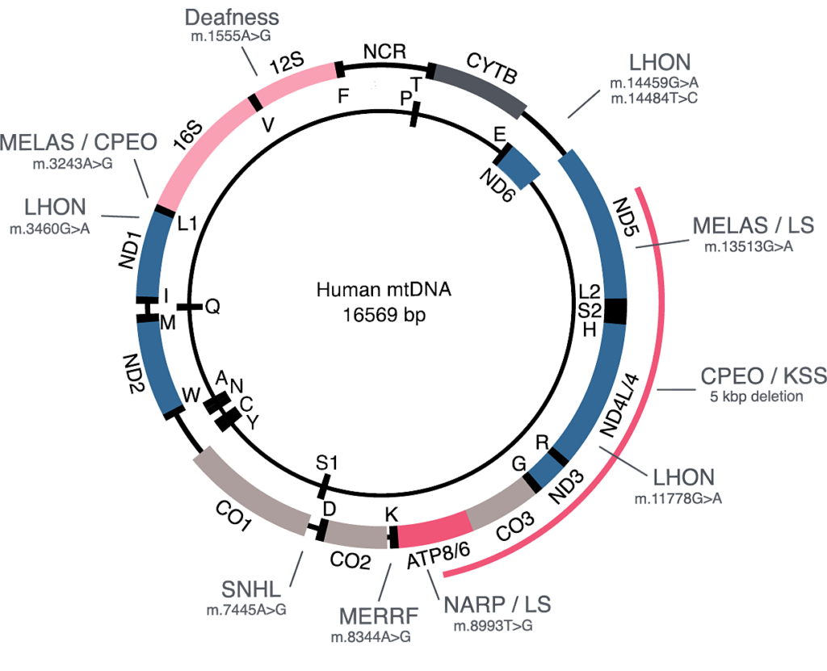
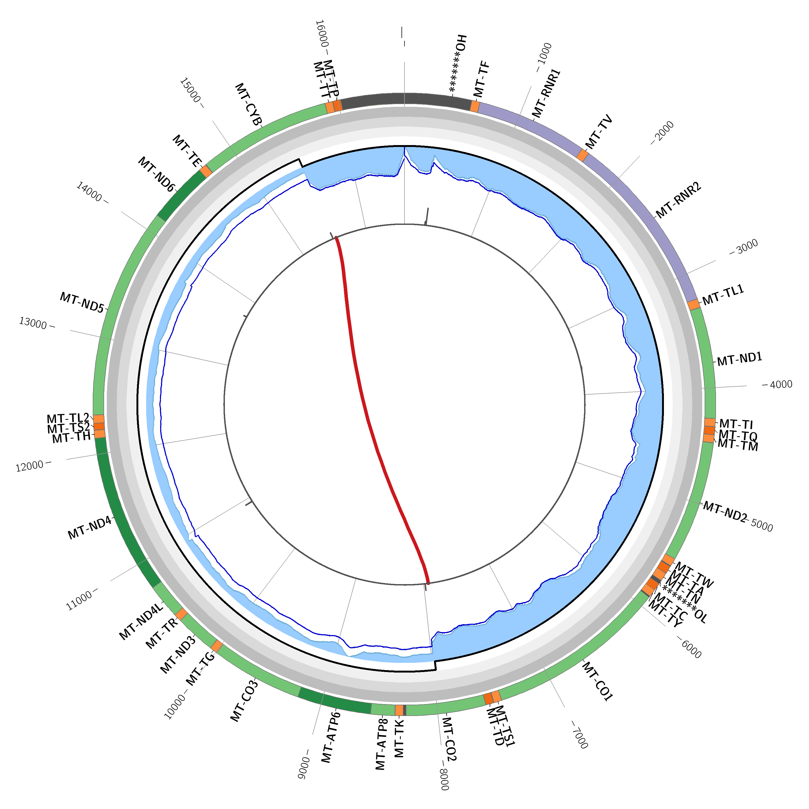
Analyzing the mitochondrial genome of over 2500 patients with retinal disease
Pernilla von Nandelstadh ¹, Sari Tuupanen ¹, Marta Gandia ¹, Sanna Vattulainen-Collanus ¹, Kati Kämpjärvi ¹, Johanna Känsäkoski ¹, Katja Merkkiniemi ¹, Laura Sarantaus ¹, Raquel Perez-Carro ¹, Jonna Tallila ¹, Ville Kytölä ¹, Mikko Muona ¹, Johanna Sistonen ¹, Inka Saarinen ¹, Juha Koskenvuo ¹, Tero-Pekka Alastalo ²
¹ Blueprint Genetics, Keilaranta 16 A-B, Espoo, 002150, Finland; ² Blueprint Genetics, 1268 Missouri Street, San Francisco, CA 04107
Purpose
Mitochondrial diseases are a heterogeneous group of disorders that arise as a result of dysfunction of the mitochondrial respiratory chain. The circular 16.5-kb mitochondrial genome (mtDNA) contains 37 genes, which are essential for normal mitochondrial function. Mitochondrial dysfunction caused by several disease-causing variants in the mtDNA has been associated with retinal disease and vision loss (Figure 1). MT-TL1 m.3243A>G, affecting the mitochondrial tRNA for leucine (UUR), is the most common pathogenic variant in the mitochondrial genome being a molecular cause in up to 11.5% of individuals with mitochondrial disease (PMID 24375076). MT-TL1 m.3243A>G is present in approximately 80% of individuals with mitochondrial myopathy, encephalopathy, lactic acidosis, and stroke-like episodes (MELAS – GeneReviews) but is also associated with isolated ophthalmologic phenotypes (PMID: 23806424, 23355809). The goal of this study was to evaluate mtDNA variants in >2500 patients with inherited retinal disease (IRD).
Results
A diagnostic (pathogenic/likely pathogenic) mtDNA variant was identified in 22 patients, contributing to a diagnostic yield of 0.85%. The diagnostic variants included 21 SNVs, of which 16 were heteroplasmic (>7%) and five were homoplasmic (Table 1 and Figure 2). The homoplasmic variants were associated mainly with Leber hereditary optic neuropathy. In addition, one heteroplasmic large deletion was identified in a patient with syndromic retinitis pigmentosa (Figure 3). Diagnostic SNV variants were identified in all together 8 mtDNA genes: MT-ND1, MT-ND4, MT-ND6, MT-ATP6, MT-TN, MT-TH, MT-TL1, and MT-TV. The most common variant was MT-TL1 m.3243A>G, identified in 11 individuals in whom the retinal disease was most often described as macular/cone dystrophy (Figure 4). Additionally, we reported a mtDNA VUS, likely to contribute to the patient’s diagnosis, in 7 cases.
Figure 1. Schematic representation of the mitochondrial genome including the ten most common mtDNA disease-causing variants. Seven of them are associated with vision loss.
Illustration based on PMID: 27023847.
Methods
We developed a highly sensitive and clinically validated mtDNA assay based on hybridization-based capture of mtDNA and next-generation sequencing (NGS) that is able to detect very low heteroplasmy levels of SNVs, INDELs and deletions. The mean read depth for the mtDNA was 18,224x, and 100% of base pairs were covered with a sequencing depth of at least 1000x. Sensitivity to detect SNVs and INDELs with over 10% heteroplasmy was 100%. For SNVs with 5-10% and <5% heteroplasmy levels the sensitivity was 93.3% and 88.9%, respectively. Sensitivity to detect large 500bp – 5,000kb deletions at 10% heteroplasmy is 99% The mtDNA assay was included in diagnostic NGS-based panel testing of 2597 IRD patients.
eKLIPse
Figure 3. An eKLIPse circos plot visualizing a 54% heteroplasmic 7.5 kb mitochondrial deletion identified in a patient referred to genetic testing with the RD panel. The deletion is encompassing 17 mitochondrial genes.
Figure 4. Phenotypes and heteroplasmy levels of 11 patients with the MT-TL1 m.3243 variant.​
* The patient had an additional molecular diagnosis in a nuclear gene.
Variant | Gene | AA change | Count | Phenotype | MITOMAP associated disease
m.1606G>A | MT-TV |  | 1 | Macular dystrophy and hearing deficit. | MM / EXIT; AMDF
m.3243A>G | MT-TL1 |  | 11 | Most often described as macular/ cone dystrophy | DM/ DMDF / SNHL / FSGS / Cardiac + multi-organ dysfunction, MELAS / LS, MM/CPEO
m.3271T>C | MT-TL1 |  | 1 | Optic atrophy. | MELAS / DM
m.5703G>A | MT-TN |  | 1 | Suspicion of CPEO and/or MM. | CPEO / MM
m.8993T>G | MT-ATP6 | Leu156Arg | 1 | Rod-cone dystrophy, neurological disease, developmental delay, cognitive impairment, and possible dystonia. | NARP / LS / other
m.11778G>A | MT-ND4 | Arg340His | 2 | Optic atrophy / cone dystrophy. | LHON / Progressive Dystonia
m.12148T>C | MT-TH |  | 1 | Suspicion of pattern dystrophy. Hearing deficit, neurological disease, kidney anomaly, and cognitive impairment. | Developmental delay, optic atrophy, cataract, hearing loss, myopathy
m.14484T>C | MT-ND6 | Met64Val | 2 | Optic neuropathy / *retinitis pigmentosa. | LHON
m.14596A>T | MT-ND6 | Ile26Met | 1 | Optic neuropathy with intermittent tremor in the hands. | LHON
Conclusions
We have developed a highly sensitive and clinically validated mtDNA assay for mitochondrial diseases
SNV diagnoses from retinal dystrophy patients were made in eight mtDNA genes in total
The most frequently implicated variant was the retinal disease-associated MT-TL1 m.3243A>G, always detected in a heteroplasmic state
Adding mtDNA analysis to routine genetic diagnostic process of IRD patients can increase the diagnostic yield by >0.85%
Analyzing the full mtDNA is beneficial as several different variants in mtDNA have been associated with both syndromic and non-syndromic IRD
Figure 2. Heteroplasmy levels of mtDNA variants in the analyzed blood/saliva samples from 22 patients with a diagnostic pathogenic/likely pathogenic mtDNA variant.
Table 1. Diagnostic mtDNA SNVs identified among 2597 IRD patients.
Abbreviations AMDF ataxia, myoclonus and deafness; CPEO chronic progressive external ophthalmoplegia; DM diabetes mellitus; DMDF DM + deafness; EXIT Exercise intolerance; FSGS Focal segmental glomerulosclerosis; LS Leigh syndrome; MELAS mitochondrial encephalomyopathy, lactic acidosis and stroke-like episodes; MM mitochondrial myopathy; NARP neurogenic muscle weakness, ataxia and retinitis pigmentosa. Reference MITOMAP: http: //www.mitomap.org. * additional molecular diagnosis in a nuclear gene.
Conflict of interest statement: All authors are employed by Blueprint Genetics.

