Slide 1
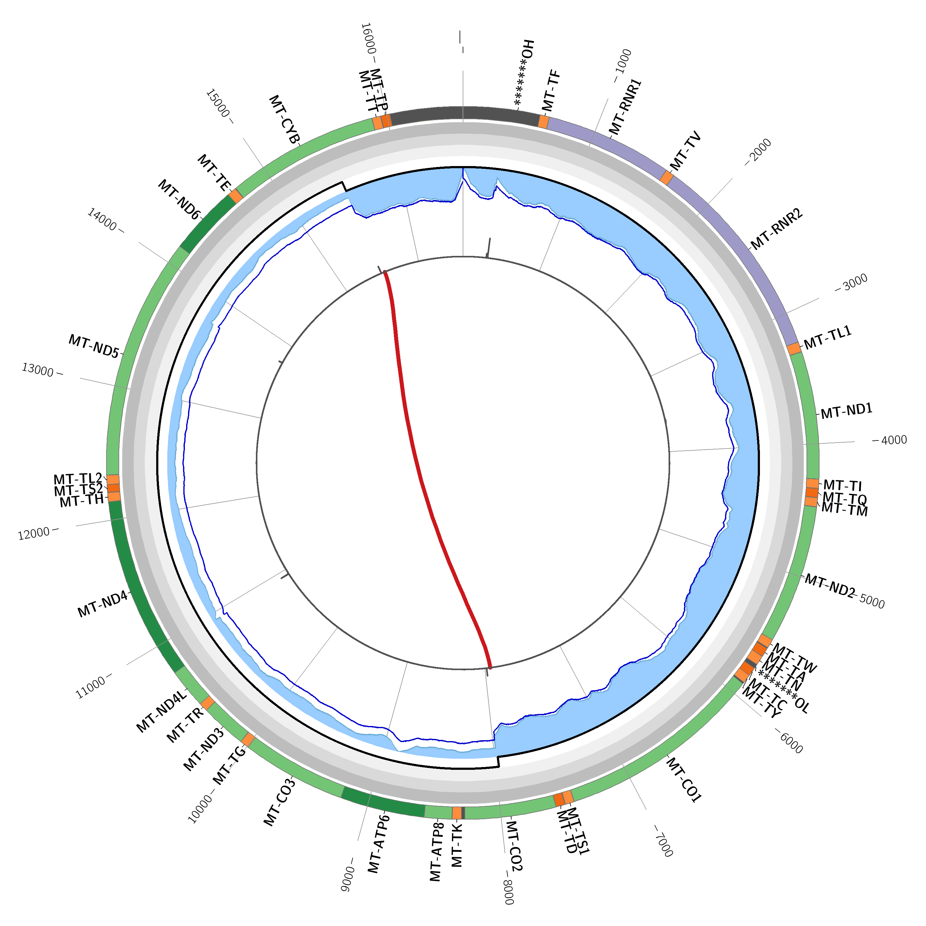
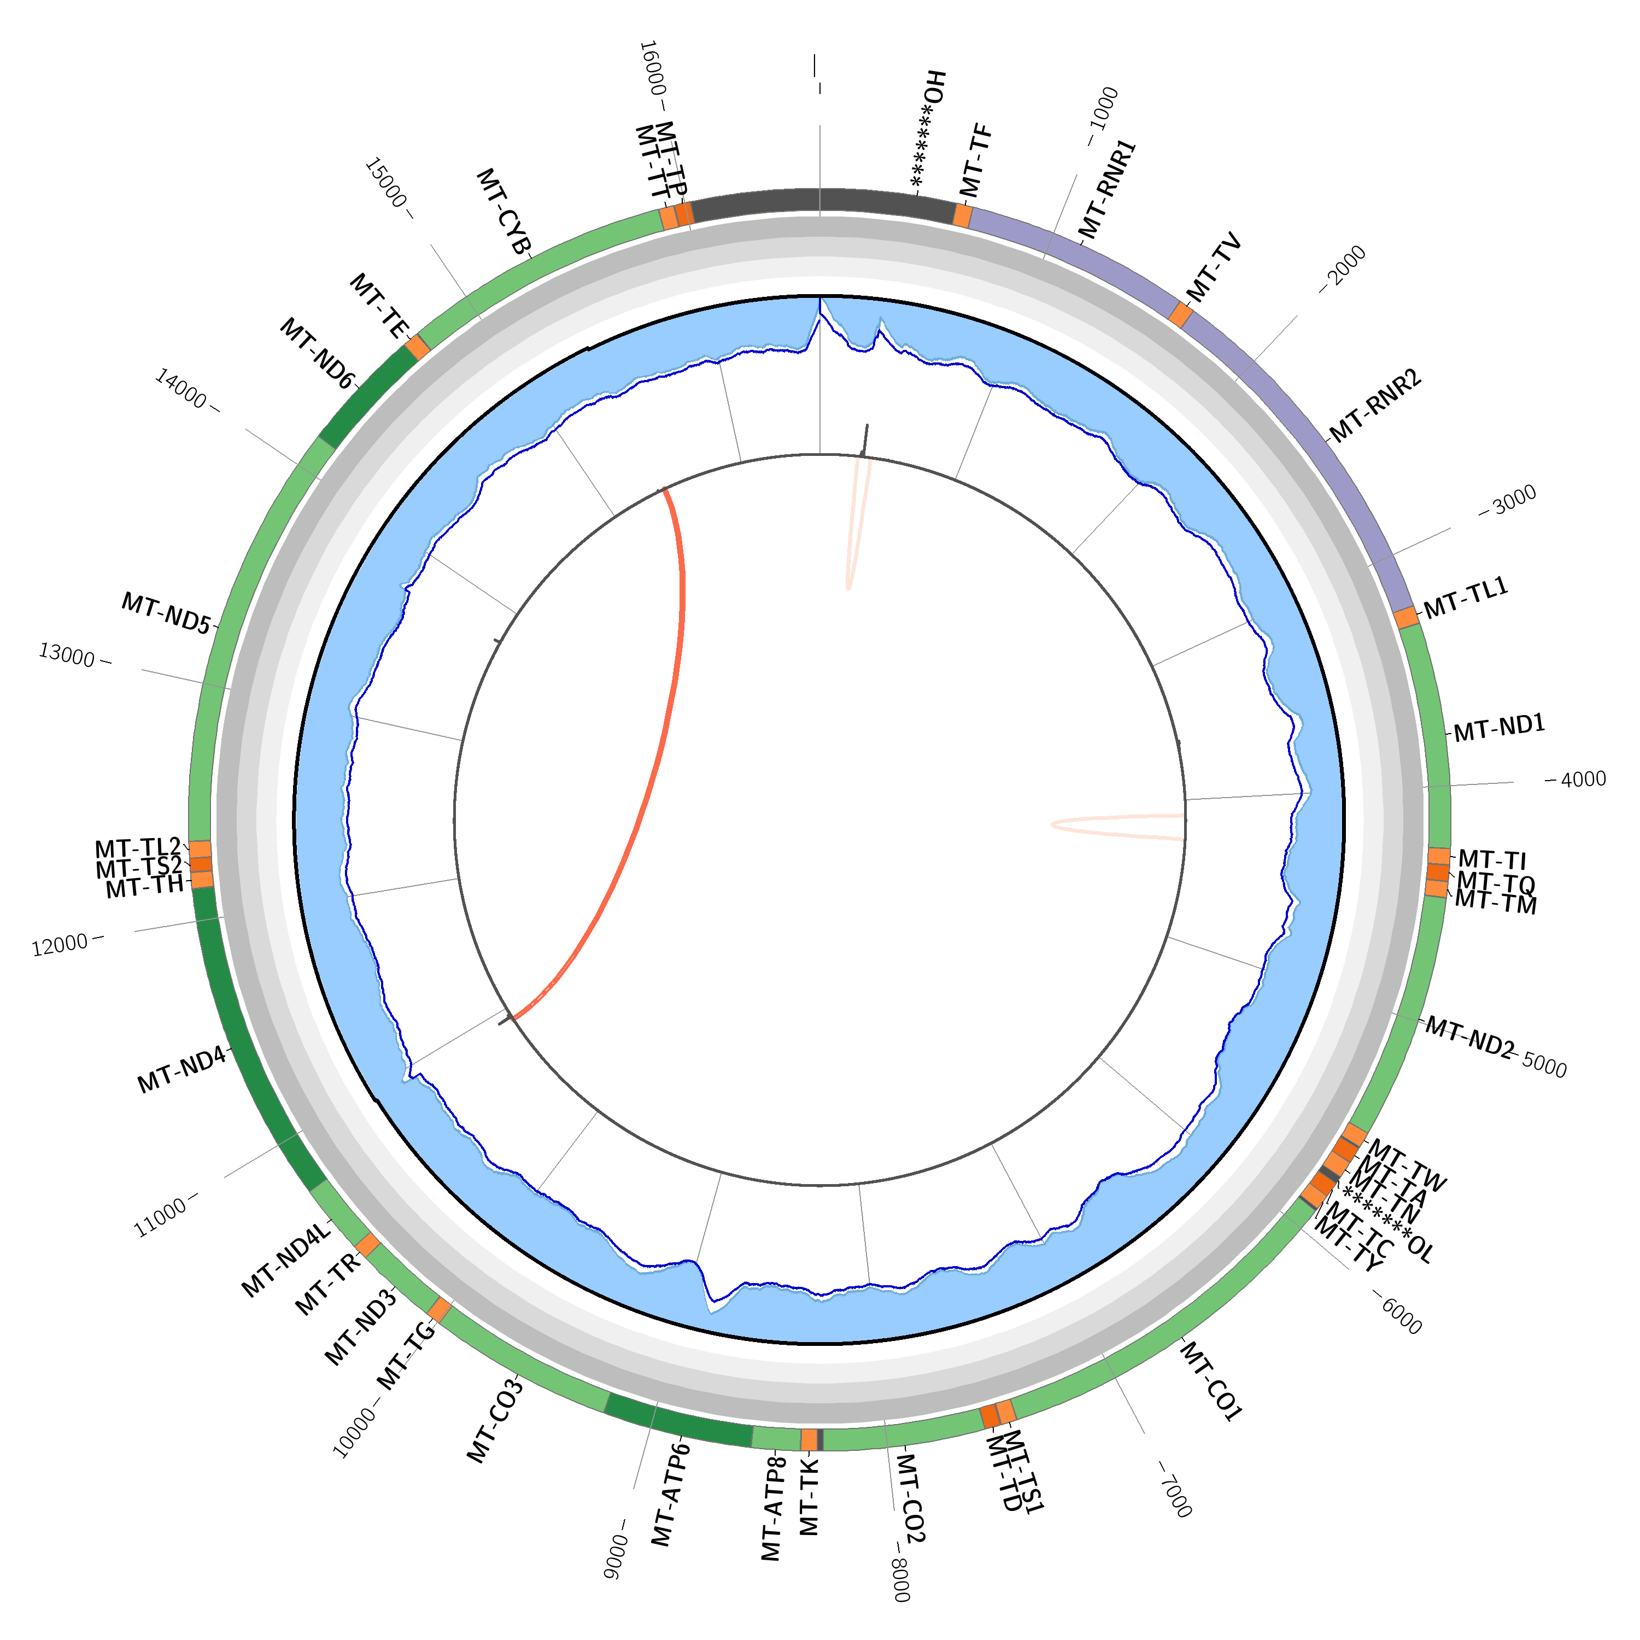
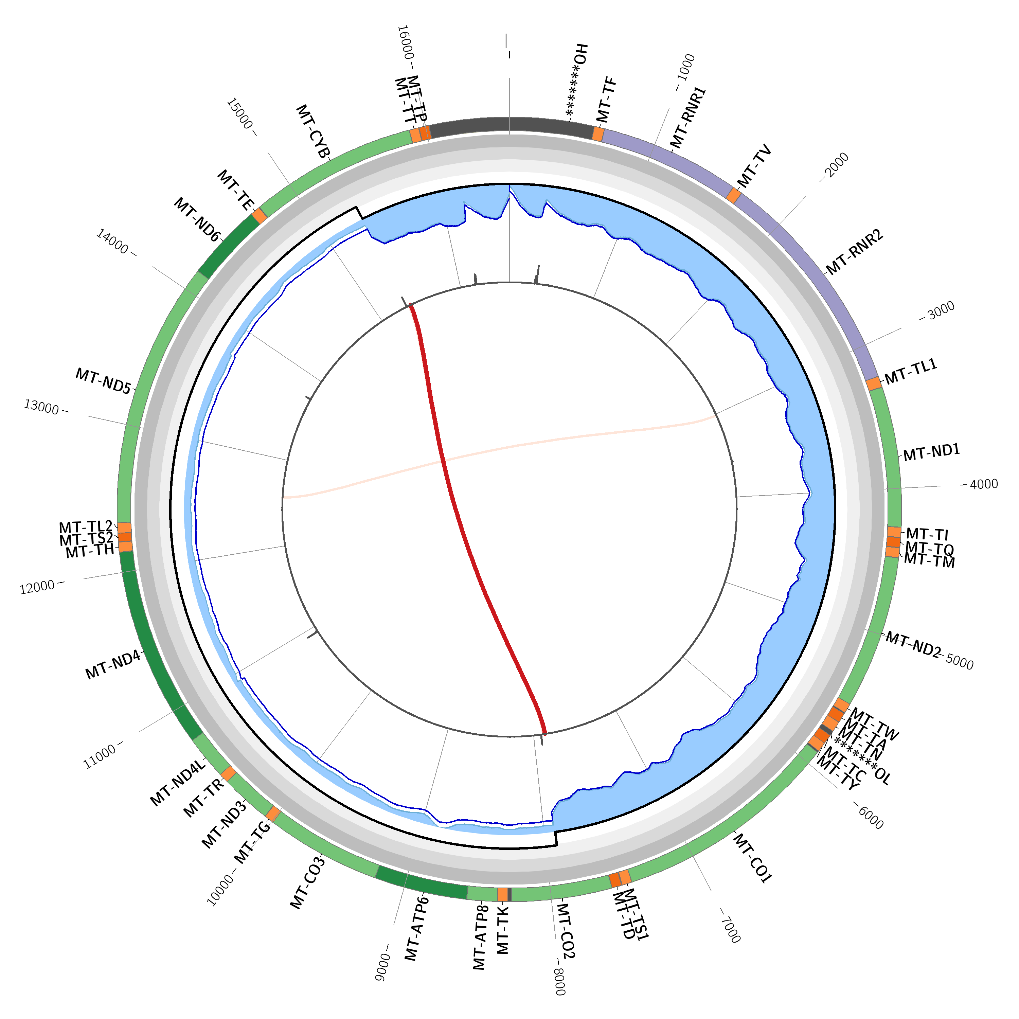
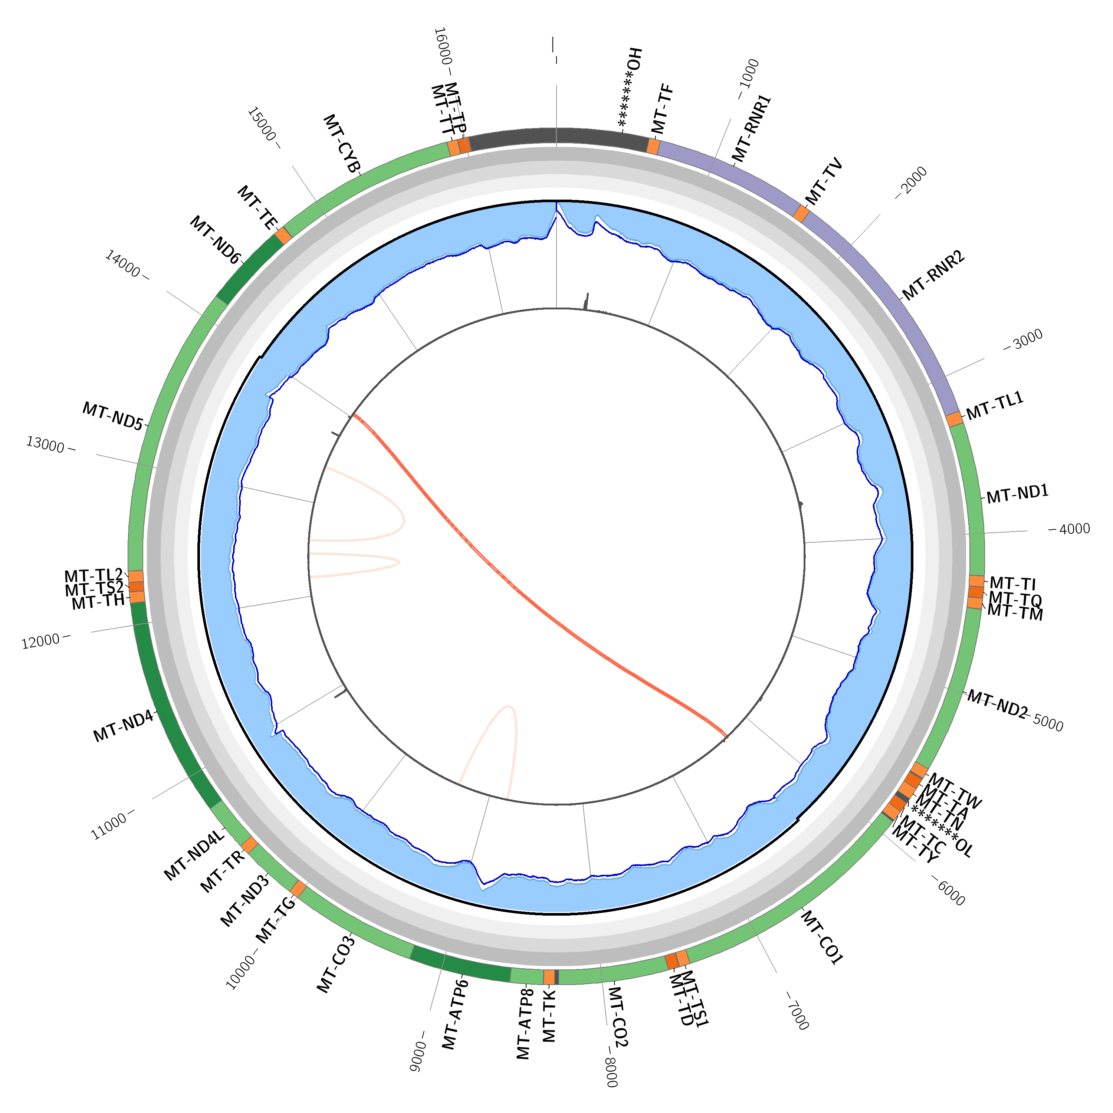
Retrospective Review of Mitochondrial Genome Analysis in Over 6,600 Cases Using Clinical Grade mtDNA Sequencing
Jennifer Schleit, Miko Valori, Ville Kytölä, Pauli Siivonen, Pertteli Salmenperä, Massimiliano Gentile, Johanna Sistonen, Jonna Tallila, Khalida Liaquat, Juha Koskenvuo, Tero-Pekka Alastalo, Marita Isokallio
¹ Blueprint Genetics Inc, Seattle, USA, ² Blueprint Genetics, Espoo, Finland
Introduction
Mitochondrial Deletions Identified
The mitochondrial genome is a circular 16.5-kb DNA molecule (mtDNA) that encodes 37 genes essential for normal mitochondrial function.
mtDNA analysis must provide reliable determination of heteroplasmy levels for accurate diagnosis of mitochondrial disease.
We performed analytic and clinical validation for an assay combining nuclear genes and mtDNA within the same test based on hybridization-based target capture and next-generation sequencing (NGS). The effect of adding mtDNA to select panels was evaluated.
Methods
Multiple wet-lab protocols and variant calling software were tested to determine the optimal set-up for detection of very low heteroplasmy levels of single- nucleotide variants (SNVs), insertions/deletions (INDELs) and larger deletions.
To account for sequence homology of nuclear mitochondrial DNA segments, which may interfere with sequence alignment and affect sensitivity, a sample from cells devoid of endogenous mitochondria was used to distinguish a mitochondrial signal from a nuclear signal.
In order to detect single large deletions and multiple low heteroplasmy level deletions, a combination of coverage and breakpoint-based analyses was used.
We added the mitochondrial genome to 30 panels in the following medical specialties: neurology, cardiology, ophthalmology, ear-nose-throat, metabolic disorders, pulmonology, mitochondrial disorders, endocrinology, and nephrology.
Retinal Dystrophy panel
Individual with syndromic presentation.
Heteroplasmic (54%) 7.5-kb deletion
Retinal Dystrophy panel
Individual with retinitis pigmentosa.
Heteroplasmic (6.8%) 4.4-kb deletion
Comprehensive Metabolism panel
Individual with suspected mitochondrial DNA depletion syndrome.
Heteroplasmic (64%) 7.4-kb deletion
Results
The mean read depth across the mitochondrial genome was 18,224X and 100% of base pairs were covered at least 1,000X.
Sensitivity to detect SNVs and INDELs with over 10% heteroplasmy was 100%.
Sensitivity was 93.3% for SNVs with 5% to 10% heteroplasmy levels and 88.9% for those with <5% heteroplasmy levels.
The sensitivity to detect simulated 500-bp to 5-kb deletions all the way down to a 10% heteroplasmy level was 99.7%.
Mitochondrial DNA Depletion panel
Two affected family members with a
heteroplasmic (12% and 20%) 7.6-kb deletion
Increased Diagnostic Yield of Panels
Figure 4. Percentage of additional diagnostic yield with mtDNA
Panel Name
Panel Name
Figure 1: Total diagnostic yield (%) of panels with reported mitochondrial variants
Diagnostic yield (%)
Figure 2: Number of pathogenic or likely pathogenic variants reported by gene
Figure 3: Number of variants of uncertain significance reported by gene
Additional diagnostic yield (%)
Adding mtDNA analysis to an NGS platform allowed detection of SNVs, INDELS, and CNVs with high sensitivity and specificity at varying levels of heteroplasmy.
Testing in 6,684 patients identified a pathogenic or likely pathogenic mtDNA variant in 76 patients, for an additional overall diagnostic yield of 1.1% overall.
Combining a high-quality mtDNA analysis with routine panel-based diagnostics has potential to improve diagnostic yield and provide a molecular diagnosis for patients with complex phenotypes.
Conclusions
Number of variants reported
Number of variants reported
Conflict of interest statement: All authors are employed by Blueprint Genetics.
Notes:
Font sizes (Arial)
Headline: 90 bold
Subheading 1: 56 bold
Subheading 2: 42 bold
Body text: 32 regular
Figure/Table title: 32 bold

