Slide 1
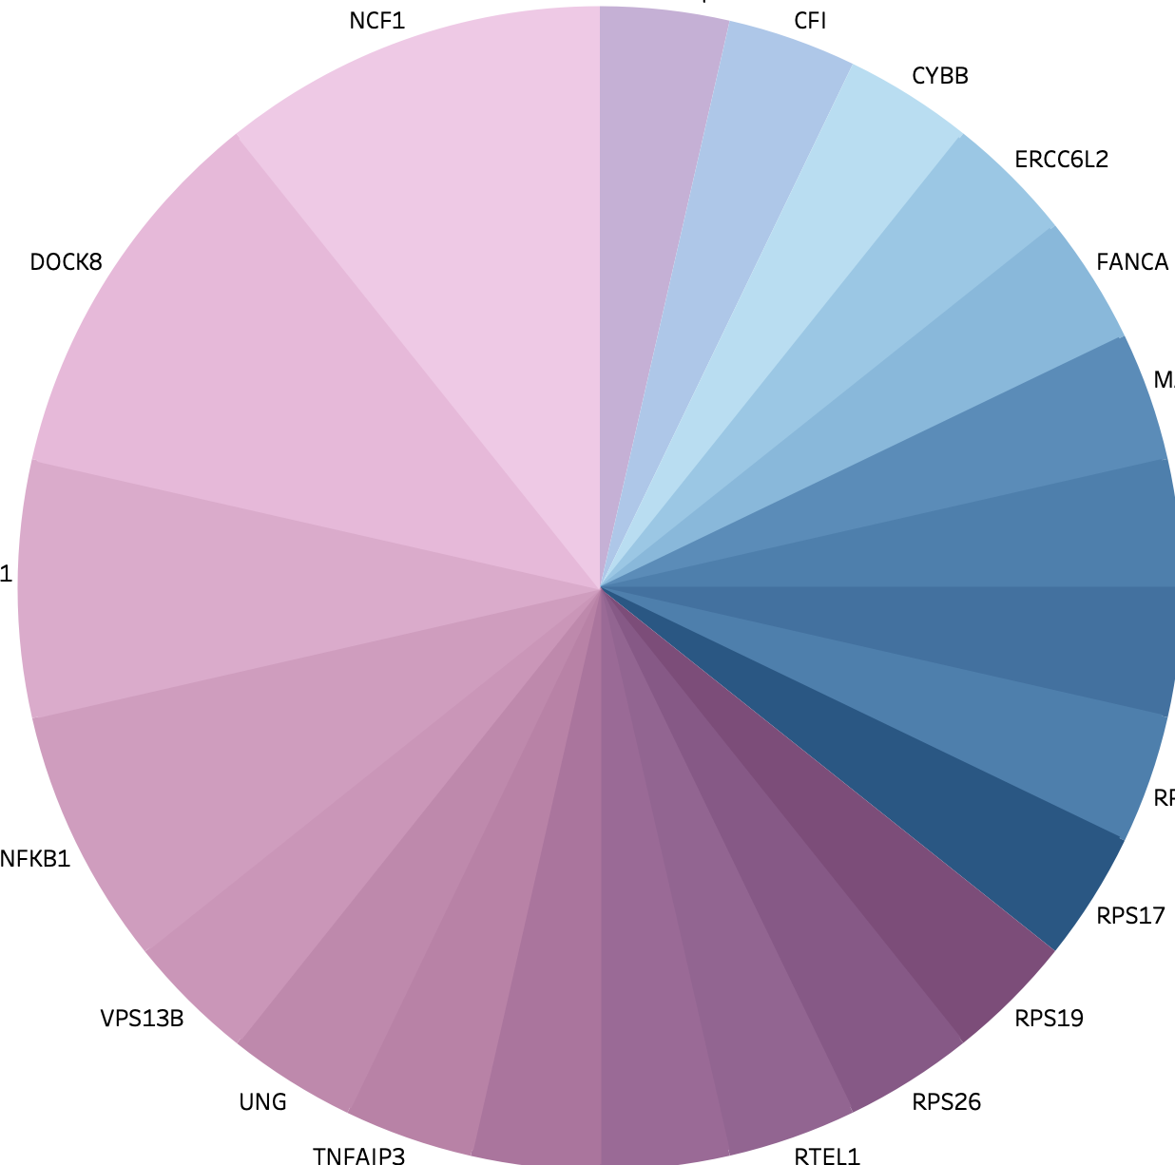
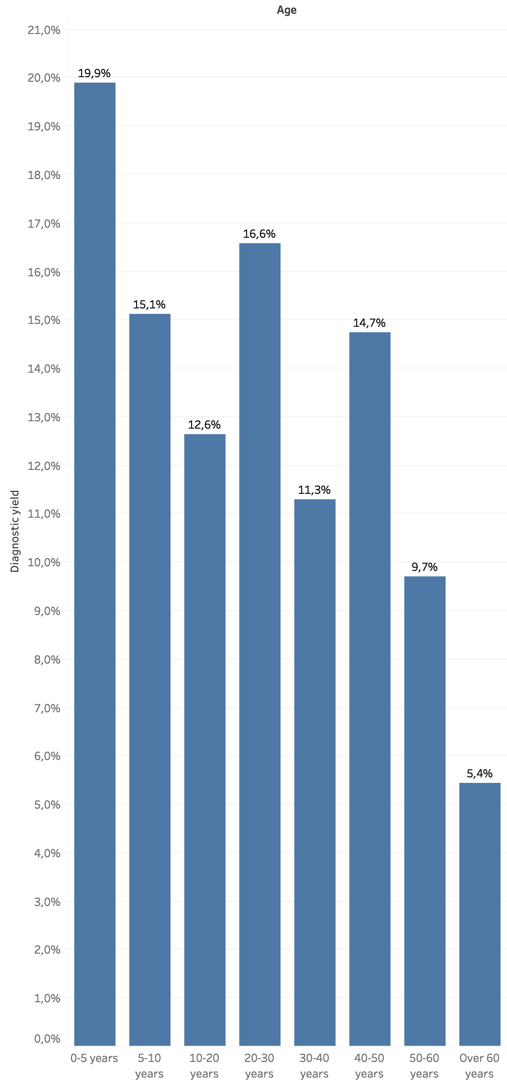
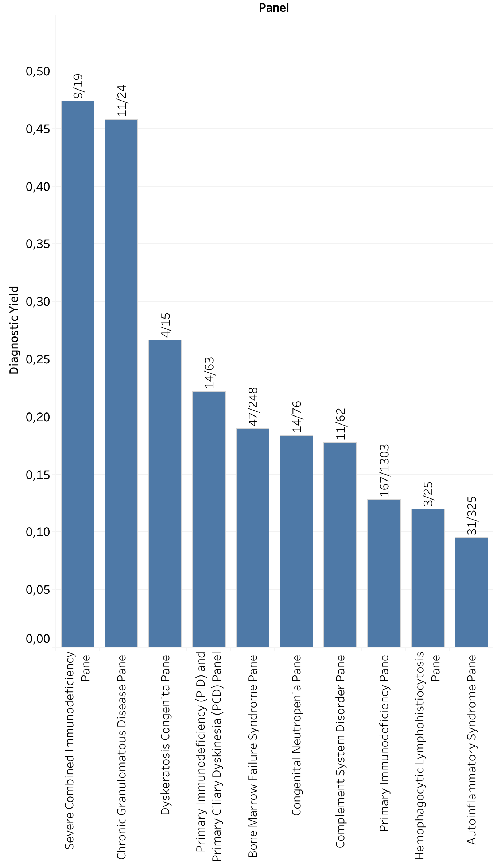
Improving the Diagnostic Yield in Patients Suspected for Primary Immunodeficiency
Anni Niskakoski¹, Päivi Kokkonen¹, Joe Jacher², Inka Saarinen¹, Lotta Koskinen¹, Johanna Sistonen¹, Heidi Junnila¹, Annakarin Kere¹, Margarita Andreevskaya¹, Mikko Muona¹, Janica Djupsjöbacka¹, Hatice Duzkale¹, Samuel Myllykangas¹, Juha Koskenvuo¹, Tero-Pekka Alastalo².
Blueprint Genetics, Helsinki, Finland¹/ Seattle, WA USA²
Introduction
Finding the genetic diagnosis for patients with suspicion of immunodeficiency is becoming increasingly important in the management of primary immunodeficiency (PID) and estimating the risk for family members^{1.} Here we report our experiences with nearly 2200 patients suspected with PIDs. Our data is based on simultaneous sequence and copy number variant (CNV) analysis combined with customized analysis for difficult to sequence regions in specific genes such as NCF1.
Methods
A retrospective review of 2162 cases sent for targeted panel testing related to PID at Blueprint Genetics was performed. Patients were tested with Blueprint Genetics next generation sequencing (NGS) related to immunology. A majority of the analyses (2095/2162, 97%) were performed combining both sequencing analysis and deletion/ duplication analysis utilizing NGS data (called as PLUS analyses). We have previously shown that our deletion/duplication analysis can identify both small deletions and duplications (1–5 exons) as well as larger CNVs. Specimens were sequenced with an Illumina NovaSeq 6000 platform.
Results
Diagnostic Yield
Diagnostic yield including all immunology related panels was 14.4% (311/2162). The highest diagnostic yield 19.9% (83/417) was observed in children from ages 0 to 5 years. The diagnostic yield was highly variable between the different panels.
Diagnostic Sequence and CNV Findings
Out of the 270 reported pathogenic (P) and likely pathogenic (LP) diagnostic sequence variants, 217 (80%) were unique. VUS1 variants (VUS favoring likely pathogenic) were excluded from this data. Altogether 30 CNVs were reported for 29 patients.
A
B
Sequence variants
CNVs
3
22q11.2
CFI
CYBB
NCF1
ERCC6L2
ONLY ONE DIAGNOSIS REPORTED FROM THESE GENES
FANCA
DOCK8
MAP2K2
2
TBX1
RPL15
RPL35A
NFKB1
RPL5
VPS13B
RPS17
1
UNG
RPS26
RPS19
TNFAIP3
STAT1
RUNX1
RTEL1
⁴
Fig. 2. Number of diagnostic findings (LP/P) in different genes; sequence variants (A) and CNVs (B).
NCF1 Custom Analysis
Homozygous deletion of NCF1 was confirmed in three chronic granulomatous disease patients by custom analysis. NCF1 gene is complicated by two highly homologous pseudogenes NCF1B and NCF1C. Homozygous deletions were detected by our CNV detection algorithm and confirmed by Sanger sequencing with primers that specifically bind to either NCF1 or the pseudogenes. Additional bioinformatic analysis targeting two specific coding positions in exons 4 and 7 that differ between the NCF1 gene and the two pseudogenes showed that all reads in those positions originated from the pseudogenes, and thus, supported the original finding.
%
Diagnostic Yield by Age
Diagnostic Yield by Panel
21
83/417
Percentage (%)
0
5
10
15
20
25
30
35
40
45
50
20
19
Severe Combined
Immunodeficiency Panel
18
Severe Combined
Immunodeficiency
9/19
17
33/199
Chronic Granulomatous
Disease Panel
11/24
16
57/377
15
23/156
Dyskeratosis Congenita Panel
4/15
14
76/601
Primary Immunodeficiency (PID) and Primary Ciliary Dyskinesia (PCD) Panel
Figure 3. NCF1 and pseudogenes NCF1B and NCF1C. Differing positions in NCF1B, NCF1C and NCF1 exons 4 and 7 used for bioinformatic analysis are highlighted.
13
14/63
12
21/186
11
13/134
Bone Marrow Failure Panel
47/248
Conclusions
Diagnostic yield in PID patients was 14.4%, and highest in children from ages 0 to 5 years 19.9%.
Diagnostic yield varied greatly between different panels related to PID.
Genetic diagnoses in PID patients are highly heterogeneous.
Our customized analysis identified 3 patients with homozygous deletion in NCF1.
Diagnostic yield (%)
10
9
Congenital Neutropenia
Panel
8
Congenital Neutropenia Panel
14/76
7
Complement System
Disorder Panel
11/62
6
5/92
5
Primary Immunodeficiency Panel
167/1303
4
3
Hemophagocytic Lymphohistiocytosis Panel
3/25
2
1
Autoinflammatory Syndrome Panel
31/325
years
0-5
5-10
10-20
20-30
30-40
40-50
50-60
60->
Fig. 1. Diagnostic yield in different age groups (A) and among different panels (B).
References:
Bousfiha A, Jeddane L et al. (2020) Human Inborn Errors of Immunity: 2019 Update of the IUIS Phenotypical Classification. J Clin Immunol.
Conflict of interest statement: All authors are employed by Blueprint Genetics.
Notes:
Font sizes (Arial)
Headline: 96 bold
Subheading 1: 56 bold
Subheading 2: 42 bold
Body text: 32 regular
Figure/Table title: 32 bold

